Slide 1
New Entrant Opportunities in Unlicensed Wireless
CFP Plenary Oct-25
Amparo Canaveras – amparoc@mit.edu
Charlie Fine

Slide 2
Wireless Dynamics in the USA
Business Dynamics
AT&T/T-mobile proposal, Light Squared
Service companies such as Google, Microsoft, Apple, Amazon, etc. may want to control their end-to-end value chains
Regulatory Dynamics
Unlicensed spectrum – White Space
Anti-trust concerns
Technology Dynamics
Cognitive Radio
LTE rollout
All these things are changing the scenario and we have an Specific Question: Why might a device company or software company or retailer (e.g., Google, Apple, Microsoft, Samsung, Best Buy) consider becoming a new-entrant wireless operator?

Slide 3
New Business Drivers Why might a device company or software company or retailer (e.g., Google, Apple, Microsoft, Samsung, Best Buy) consider becoming a wireless operator?
Access to Customers
Need to connect with people when they are using their mobile device
Access to Advertisers
Advertisers need specific messaging for each platform (mobile or fixed)
Provide a complete end-to-end Service
Retailers need to accept transaction via a phone

Slide 4
New Regulatory Framework in USA
FCC seeks to confront high demand for Radio
Make more spectrum available: Broadband Plan of the FCC aims to make an additional 500 MHz of spectrum
Enhance the spectrum efficiency with regulatory frameworks for:
Cognitive Radios which will allow the access to underused resources such as the military spectrum
Geo-location databases which will allow the coexistence of different protocols
New rules for (unlicensed) TV White Space

Slide 5
New Enabling Technologies
LTE cellular, new all-IP architecture
IEEE 802.22-2011, Regional area network
IEEE 802.19.1, Wireless Coexistence in the TV Bands
IETF PAWS, Protocol to Access White Space database
Geo-database and sensing (SE43)(*)
Proprietary cognitive radios – 6Harmonics, Adapt4, Adaptrum, Aviacomm/Carlson Wireless/Neul,(*)
(*) Reference :Peter Ecclesine

Slide 6
Modeling the USA Wireless Industry
We have assumed the conditions of a new entrant wireless operator with different technologies
We have modeled the potential demand for a new operator based on QoS and Service Availability.
The model can calculate the required capacity and network costs based on available technologies
We have simulated potential network revenues based on different assumptions on service price
We have performed break-even study analysis of two new potential wireless service providers

Slide 7
case study #1
New entrant exploiting new features of LTE

Slide 8
Case study #1: Scenario
New Wireless Operator buying Spectrum and deploying an LTE network for Wireless Broadband connectivity
Operator covers 80% of USA population
Spectrum
Price: $3,875,663,800.00 (*)
Capacity: 10 MHz
Service Configuration
Device Connectivity
Service Price: 60$ per month
(Reference: Price paid in 2008 auction for Block A (12 MHz) )

Slide 9
Base Case: Greenfield operator results NOT profitable with low price/low quality strategy or with high price/high quality strategy
HSPA Incumbent
HSPA Incumbent
LTE Incumbent
LTE Incumbent
LTE Entrant
LTE Entrant
Low price/Quality Strategy
High Quality/Price Strategy

Slide 10
At what capex per base station can a new LTE entrant be profitable?
From $180.000 to $80.000

Slide 11
At what ARPU per customer can a new LTE entrant be profitable?
From $60 to $90

Slide 12
What could be a good combination of improvements ?
Base Station = $150.000 (5/6)
ARPU = $80 (4/3)
Base Station Cost = $120.000 (2/3)
Base Station OPEX= $12.000 (2/3)

Slide 13
case study #2
New entry opportunity due to a new policy change:
Availability of TVWS

Slide 14
Case Study #2: Scenario
Entrant Wireless Broadband Provider using unlicensed Spectrum with a combination of technologies 802.22, 802.11af and standard Wi-Fi
Users pay a monthly fee for a Wi-Fi router at home and Wi-Fi connectivity where available
TVWS makes economic sense primarily in rural areas, so any successful business model using TVWS is likely to be focused on such areas or be partnered with LTE or urban Wi-Fi for the cities. We model the latter only here.

Slide 15
Case Study #2: Unlicensed Wireless Technologies
TVWS – 802.11af
TVWS – 802.22
WLAN-5 – Wi-Fi
Reference from Peter Ecclesine

Slide 16
How to deploy profitable networks with unlicensed technologies?
5 Channels
4 Channels
Wi-Fi
Wi-Fi/802.11af
802.22
10%
Urban
Areas
10%
Suburban
TVWS available
80%
Rural
3 Channels
Use a mix of technologies
Use each technology in its best environment

Slide 17
Issues with licensed-exempt spectrum #1
Standards for unlicensed spectrum incorporate interference avoidance mechanisms but no QoS is guaranteed
In the proposed scenarios we have assumed that user will pay the same price for both LTE and unlicensed services. Further scenarios about service price reductions are needed
802.22 standard has been already released but manufacturing intentions are not yet available
802.11af has not been released yet and first devices are expected to be certified by 2013
Countries are under financial pressure and will prefer to generate cash from available TV spectrum

Slide 18
Conclusions
New regulatory scenarios along with new enabling technologies might pave the way for new players in the wireless industry
Considerable reductions in LTE costs are required to make the business case for new telecom entrants possible (assuming they have already established billing, customer relationships, etc., e.g., Apple, Amazon, …).
Commercial Unlicensed Networks are already viable (e.g. Boingo) and TVWS can enhance their business case by providing more coverage range
Existing political scenario will induce many countries to sell the upper part of the TV spectrum, which will considerable reduce the White Spaces opportunity

Slide 19
Thanks
Q&A

Slide 20
Back-up slides

Slide 21
Network Parameters Assumptions
LTE
Capex: $180.000/unit
Opex: $18.000 (10% Capex)/year
Capacity: 522 Users (*)
Coverage: 4 km2 (dense urban), 16km2 (urban) 100km2 (suburban)(*)
Wi-Fi
Capex: $ 4,450 /unit
Opex: $445 (10% Capex)/year
Capacity: 45 Users (**)
Coverage: 0.023km2
(*) LTE for UMTS: OFDMA and SC-FDMA Based Radio Access
(**) http://pdf.ruckuscdn.com/product-info/wba_business_case.pdf
(*) LTE for UMTS: OFDMA and SC-FDMA Based Radio Access

Slide 22
Network Parameters Assumptions
Wi-Fi af
Capex: $9000/unit(*)
Opex: $900 (10% Capex)/year
Capacity: 45 Users (*)
Coverage: 0.22 km2 (**)
802.22
Capex: $100.000/unit
Opex: $10.000 (10% Capex)/year
Capacity: 55 Users (***)
Coverage: 320km2 (***)
(*) Assumed price two times existing Wi-Fi but same capacity
(**) http://arstechnica.com/tech-policy/news/2009/09/whitefi-could-be-worth-15-billion-a-yearand-fix-climate-change.ars
(***) Calculations made assuming 4 Mbps downlink 1 Mbps uplink and using 600-700MHZ band
(*) LTE for UMTS: OFDMA and SC-FDMA Based Radio Access

Slide 23
At what opex per base station can a new LTE entrant be profitable?
From $18.000/year to $6.000/year

Slide 24
Issues with licensed-exempt spectrum #3
European countries are under financial pressure and prefer to generate cash from available TV spectrum
US Joint Select Committee on Deficit Reduction has a $24B goal for auctioned spectrum
Entirely likely will recommend consolidating DTV broadcasters on fewer TV channels and auction off unused spectrum

Slide 25
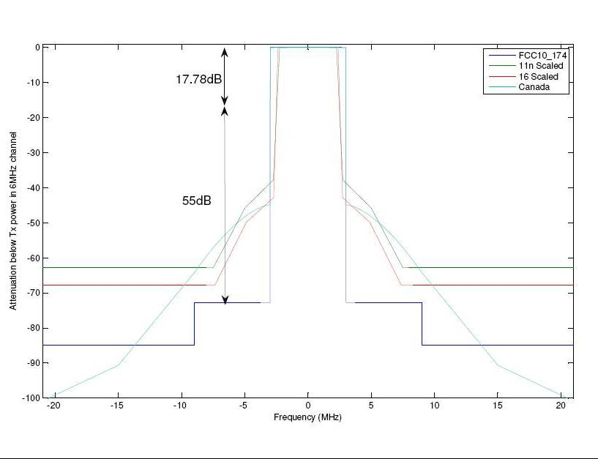
Issues with licensed-exempt spectrum #2
Countries are under financial pressure and prefer to generate cash from available TV spectrum
802.11af Physical Layer cannot meet the strong FCC
frequency mask requirements

